Slide 1
Reconstructing the Duplication History of a Tandem Repeat
Gary Benson and Lan Dong，
Proceedings of the Seventh International Conference on Intelligent Systems for Molecular Biology ，1999
Jian-Fu Dong

Slide 2
Abstract(1)
One of the less well understood mutational transformations that act upon DNA is tandem duplication. In this process, a stretch of DNA is duplicated to produce two or more adjacent copies, resulting in a tandem repeat. Over time, the copies undergo additional mutations so that typically, multiple approximate tandem copies are present. An interesting feature of tandem repeats is that the duplicated copies are preserved together, making it possible to do “phylogenetic analysis” on a single sequence. This involves using the pattern of mutations among the copies to determine a minimal or a most likely history for the repeat.

Slide 3
Abstract(2)
A history tries to describe the interworven pattern of substitutions, indels, and duplication events in such a way as to minimize the number of identical mutations that arise independently. Because the copies are adjacent and ordered, the history problem can not be solved by standard phylogeny algorithms. In this paper, we introduce several versions of the tandem repeat history problem, develop algorithmic solutions and evaluate their performance. We also develop ways to visualize important features of a history with the goal of discovering properties of the duplication mechanism

Slide 4
What is tandem repeat ?
…TCCGA…. －＞ …TCCGCGGCGGA…
ABCDABCDABCD －＞ ABCDABCDABCDABCD
ABCDABCDABCD －＞ ABCDABCDABCDABCD

Slide 5
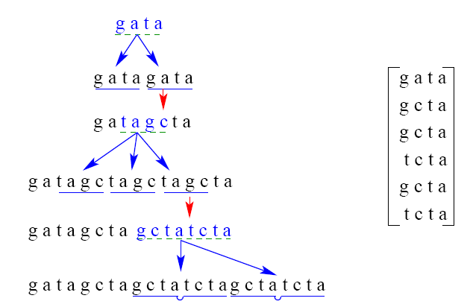
Tandem Repeat History

Slide 6
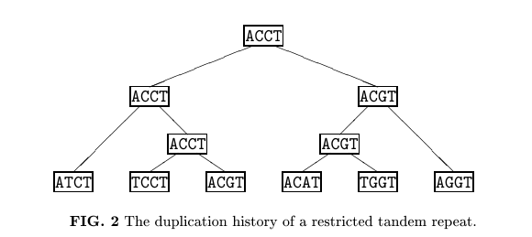
Tandem Repeat History Tree
－＞ATCTTCCTACGTACATTGGTAGGT

Slide 7
Tandem Repeat History Problem Definition
Instance :
A string S=S₁S₂….S_{n}, where are length m string over alphabet {A,C,G,T,-} and come from a multiple sequence alignment of the copies of a tandem repeat；A contraction cost function
Objective :
Find a series of contractions that reduce S to an ancestral sequence of length m and have the minimum cost. (NP-hard)

Slide 8
Restricted Tandem Repeat History
Instance :
A string S=S₁S₂….S_{n}, where S₁,S₂, S_{n} are length m string over alphabet {A,C,G,T,-}
Objective :
Find an ordered binary tree T where each node is labeled by a length m sequence over {A, C, G, T, -},the leaves are labeled, from left to right, by S₁,S₂, …S_{n}, respectively and c(T) is minimized (NP-hard)

Slide 9
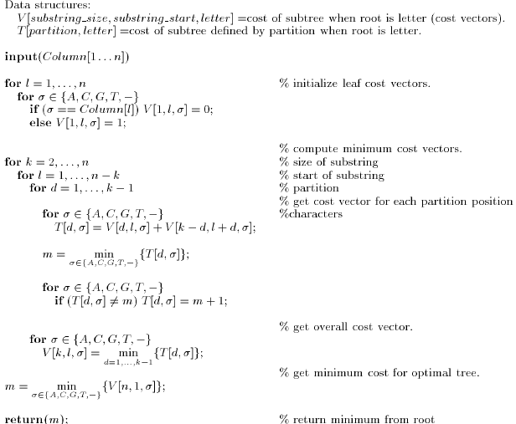
Greedy Algorithm of Single column, fixed duplication size, binary contractions

Slide 10
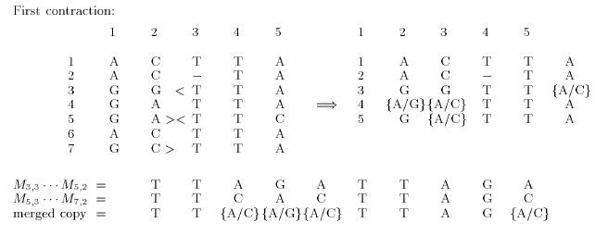
Binary Contraction Example(1)

Slide 11
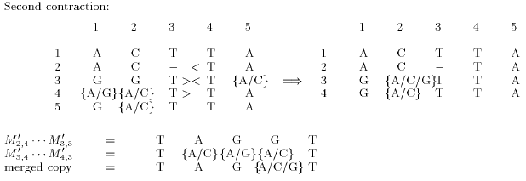
Binary Contraction Example(2)

Slide 12
Operation Example
Round 1
1 2 3 4 5
1 A C T T A
2 A C – T A
3 G G T T A
4 G A T T A .
5 G A T T C .
6 A C T T A .
7 G C T T A
Round 2
1 2 3 4 5
1 A C T T A
2 A C – T A
3 G G T T A
4 G A T T A .
5 G A T T C .
6 A C T T A .
7 G C T T A

Slide 13
Time Complexity
Binary Contraction :
  single column : n³
  r columns : rn³ ( or 5^{r} × n³)
Many to One Contraction : rn³log(n)

Slide 14
Reference
Eric Rivals. A Survey on Algorithmic Aspects of Tandem Repeats
Deep Jaitly, Paul Kearney, Guo-Hui Lin,Bin Ma. Methods for Reconstructing the History of Tandem Repeats and their Application to the Human Genome

